Slide 1
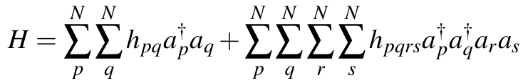
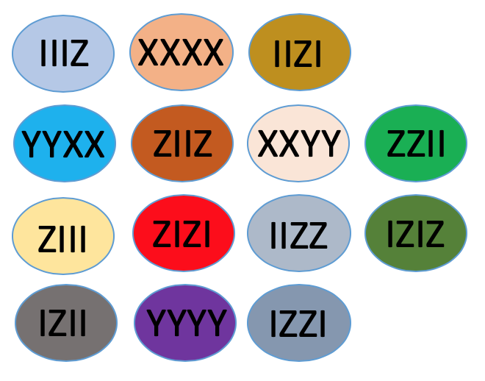
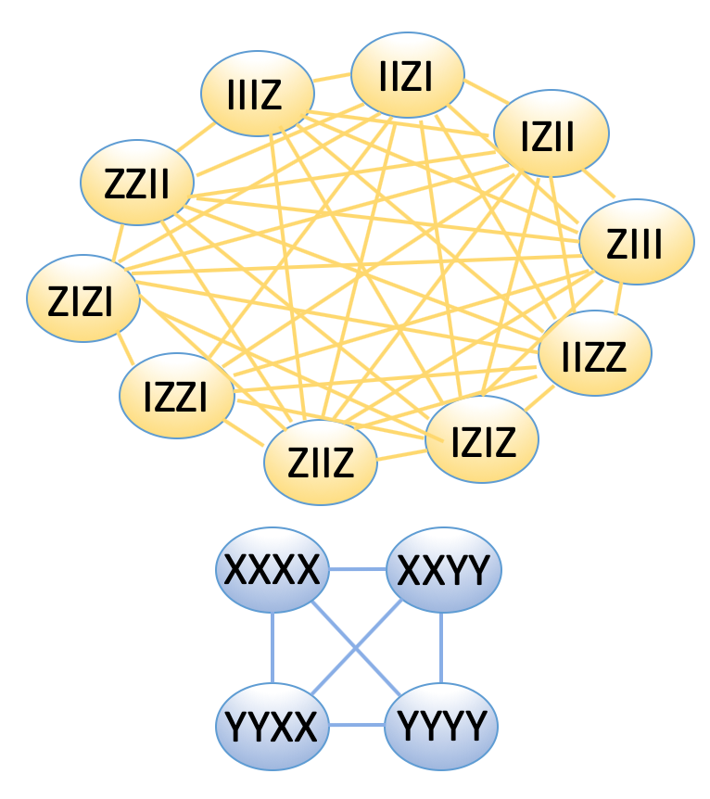
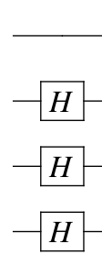
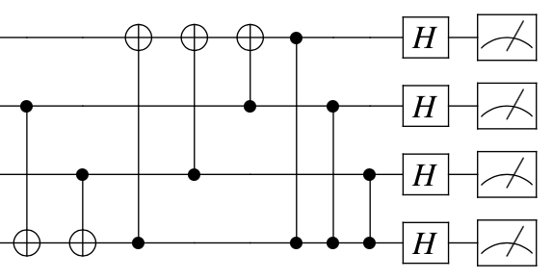
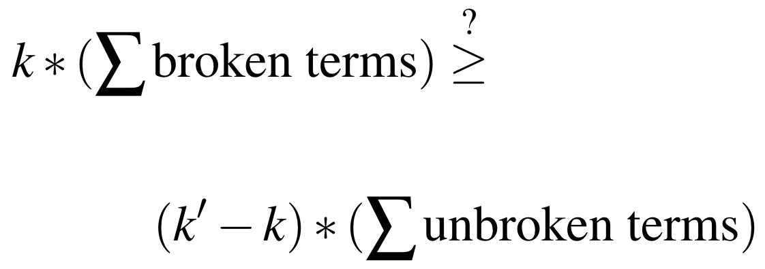
Molecular Model (Hamiltonian)
Qubit Representation
§4
§5
XIXY + XXYY + ZZII + …
OR
*Naïve Measurement*
*Simultaneous Measurement*
Transpilation (§4-5)
OR
Covariance
Mitigation (§9)
Measurement Circuit Synthesis (§6)
14 measurements
2 measurements
Classical
post-processing (§6.2)
14 measurement values
14 measurement values

Slide 2
IIIZ
IIZI
IZII
ZZII
ZIII
ZIZI
IIZZ
IZZI
ZIIZ
IZIZ
XXXX
XXYY
YYXX
YYYY

Slide 3
XXYY
IIIZ
IIZI
IZII
XXXX
ZZII
ZIII
ZIZI
YYXX
IIZZ
IZZI
YYYY
ZIIZ
IZIZ

Slide 4
IIIZ
XXXX
IIZI
YYXX
ZIIZ
XXYY
ZZII
ZIII
ZIZI
IIZZ
IZIZ
IZII
YYYY
IZZI

